Slide 1
Module 5.2: Web Security Definitions, Goals and Threat Models
What makes web a dangerous place?

Slide 2
Web security
Browser security model
The browser as an OS and execution platform
Protocols, isolation, communication, …
Web application security
Application pitfalls and defenses
Content security policies
Additional mechanisms for sandboxing and security
Authentication and session management
How users authenticate to web sites
Browser-server mechanisms for managing state
HTTPS: goals and pitfalls
Network issues and browser protocol handling

Slide 3
Web programming poll
Familiar with basic html?
Developed a web application using:
Apache? PHP? Ruby?
Python? SQL?
JavaScript? CSS?
JSON?
Know about:
postMessage? NaCL? Webworkers? CSP?
WebView?
Resource: http://www.w3schools.com/

Slide 4
Goals of web security
Safely browse the web
Users should be able to visit a variety of web sites, without incurring harm:
No stolen information
Site A cannot compromise session at Site B
Support secure web applications
Applications delivered over the web should be able to achieve the same security properties as stand-alone applications

Slide 5

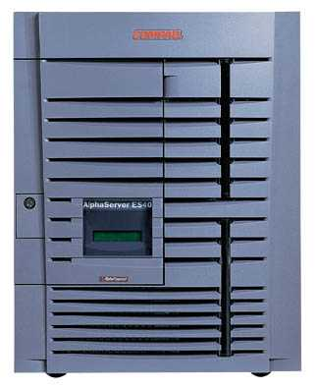


Web security threat model
System
Web Attacker
Sets up malicious site visited by victim; no control of network
Alice

Slide 6
Network security threat model
Network Attacker
Intercepts and controls network communication
System
Alice

Slide 7
System
Web Attacker
Alice
Network Attacker
System
Alice

Slide 8
Web Threat Models
Web attacker
Control attacker.com
Can obtain SSL/TLS certificate for attacker.com
User visits attacker.com
Or: runs attacker’s Facebook app, etc.
Network attacker
Passive: Wireless eavesdropper
Active: Evil router, DNS poisoning
Malware attacker
Attacker escapes browser isolation mechanisms and run separately under control of OS

Slide 9
Malware attacker
Browsers may contain exploitable bugs
Often enable remote code execution by web sites
Google study: [the ghost in the browser 2007]
Found Trojans on 300,000 web pages (URLs)
Found adware on 18,000 web pages (URLs)
Even if browsers were bug-free, still lots of vulnerabilities on the web
All of the vulnerabilities on previous graph: XSS, SQLi, CSRF, …
NOT OUR FOCUS IN THIS PART OF COURSE

Slide 10
Web Security Issues
Http
Rendering content
Isolation
Communication
Navigation
Security User Interface
Cookies
Frames and frame busting

